Slide 1


Web Application for IITGN Sentry
CSS 433-Computer Networks
Computer Science and Engineering
Netram Choudhary 21110138
Marka Vinay Goud 21110125
Katlagunta Sujith 21110100
Course instructor : Sameer Kulkarni
Project TA : Satyam Bhardwaj

Slide 2

BACKGROUND STUDY
Meeting with security guards at the Indian Institute of Technology Gandhinagar
Found specific requirements and challenges faced by the security personnel during visitor check-in and check-out procedures.
In the course of our interactions with the security personnel, we inquired about the specific features they envisioned in the web application.
We took note of what security guards usually record in their registers to ensure our web app includes those essential details.

Slide 3

FEATURES AND FUNCTIONALITY

Slide 4

Authentication System
User and Admin Authentication
- Implemented secure authentication for users and administrators, ensuring authorized access.
Admin Approval
- Implemented an admin approval process for heightened security, restricting app access to specifically approved individuals rather than through conventional login/signup methods

Slide 5
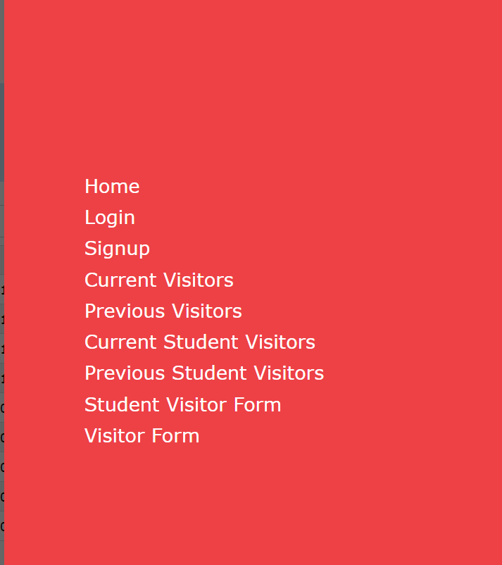
Navigation Bar
Integrated a user-friendly navigation bar enabling seamless or easy redirection movement between different system sections
Responsive Design: Ensured the entire application was responsive, optimizing its display for various devices and screen sizes
Enhanced UI: Implemented a visually appealing interface that simplifies navigation and interaction across the system

Slide 6
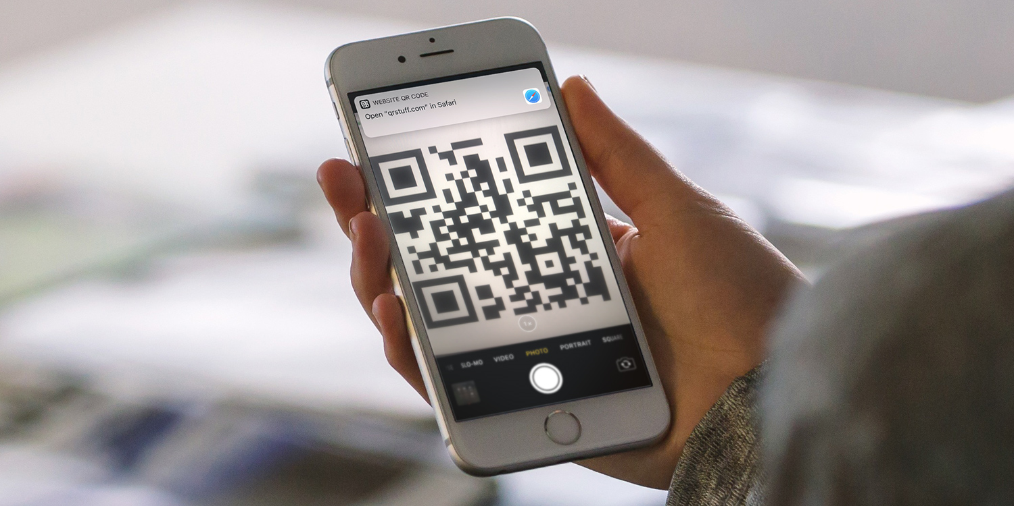
QR Code Based Entry System
Efficient form filling through QR codes.
Simplifying the check-in process.

Slide 7

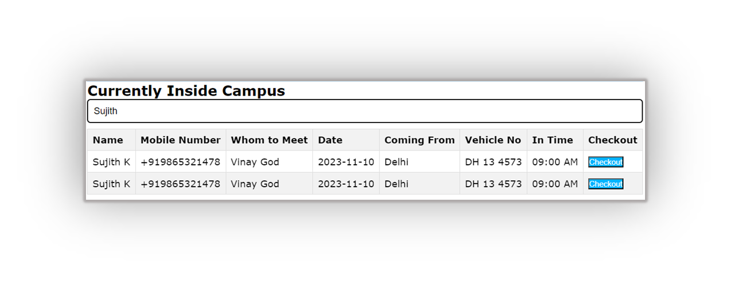
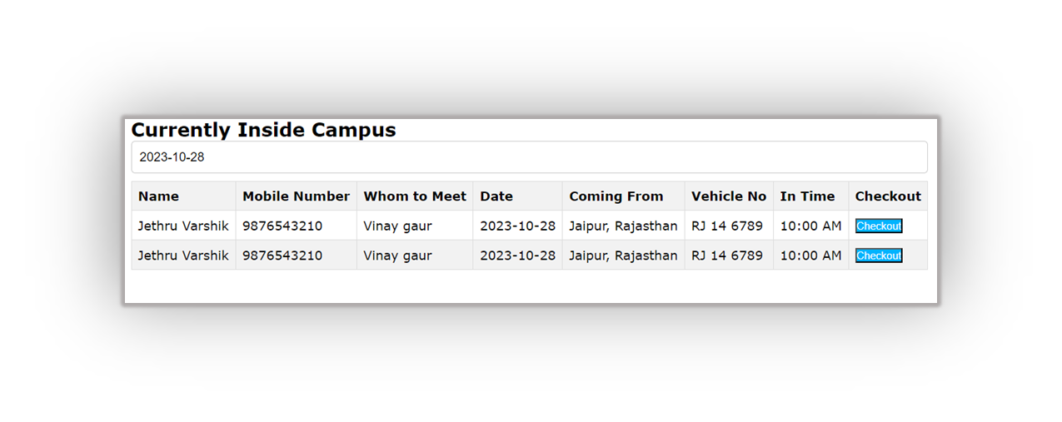
Visitor search
Enabled security personnel to search for visitors based on various criteria such as name, time, date of entry, or address
Searching by the visitor's name (Sujith)
Searching based on the date(2023-10-28)

Slide 8
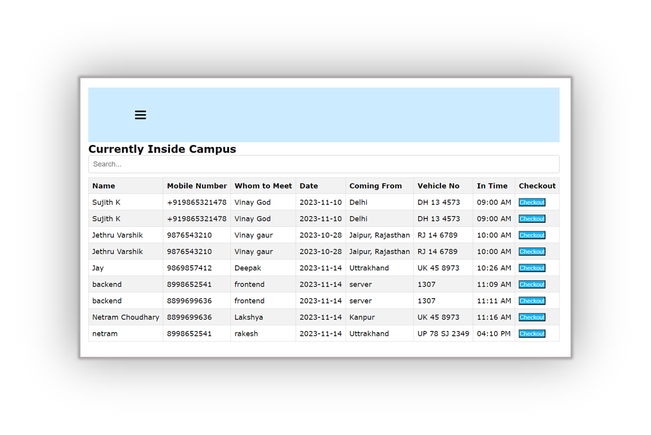
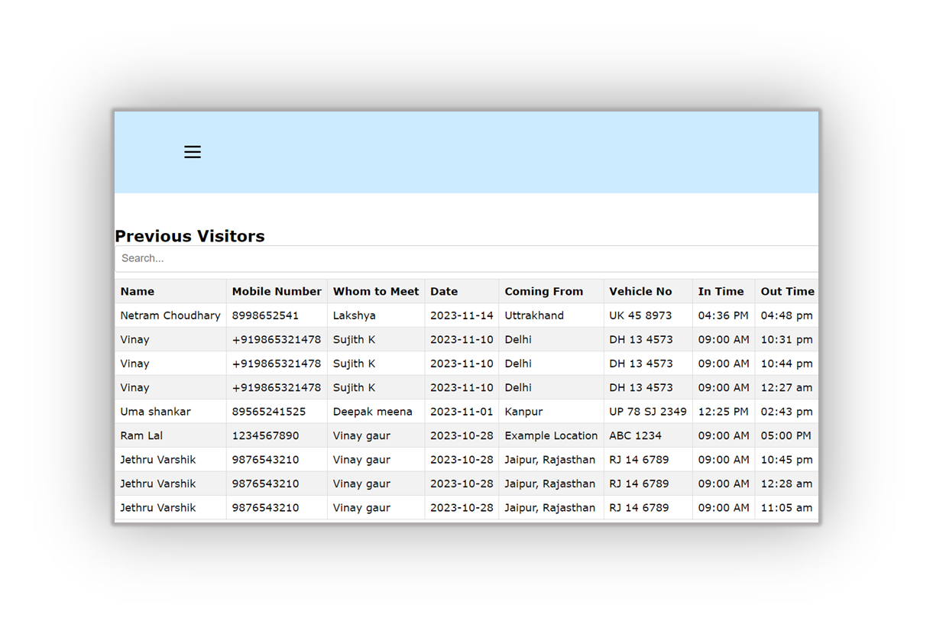
Different Types of Visitor Interfaces
Similar Interfaces are made for tracking Information of Student Related Visitors too
Created a user-friendly registration process that collects visitor information validates, and stores it securely in the database.
Check-In/Check-Out: Developed logic to record visitor entry and exit times accurately, offering efficient tracking and monitoring

Slide 9
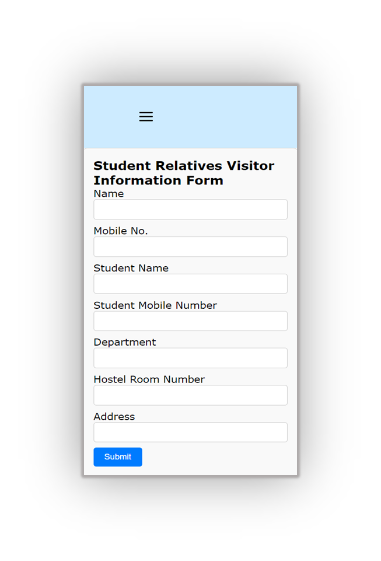
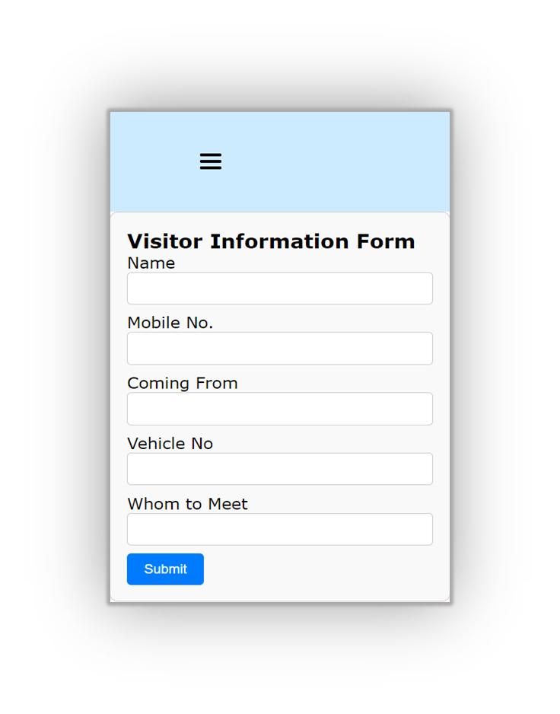
Different Types of Visitor Registration forms

Slide 10
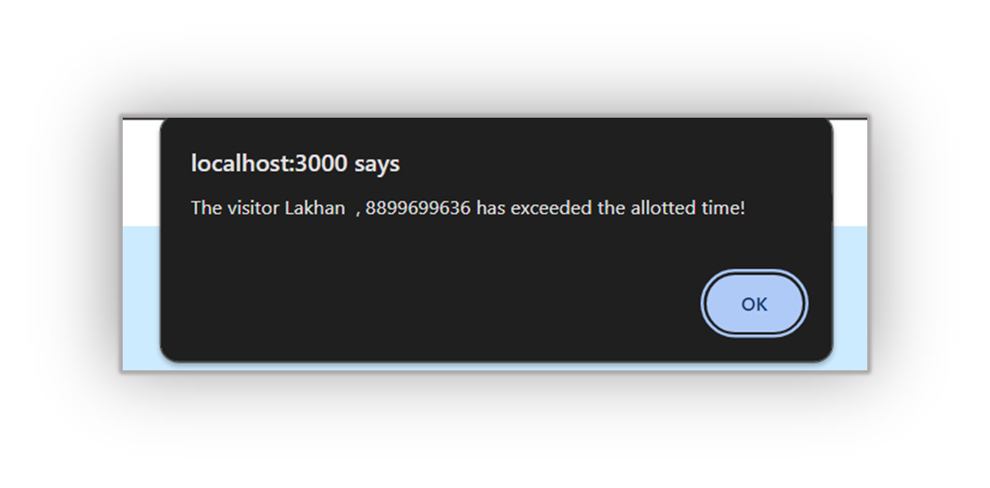
Visitor Overstay Alerts
Real-time alerts for exceeded visitor durations.
Name and mobile number of the Visitor will be displayed over the Notification.

Slide 11

AWS Cloud-Based Data Management
Leveraged MongoDB Atlas, a fully managed database service, for secure and reliable storage of visitor-related data.
Implemented a cloud-based approach on AWS for seamless scalability, effortlessly adapting to changing needs and increasing data volumes.
Utilized AWS cloud infrastructure, enhancing reliability and providing high accessibility with a distributed and redundant architecture.
Aligned with modern best practices, the MongoDB Atlas on AWS serves as a resilient foundation for the application's backend, ensuring efficient and secure data storage support.

Slide 12

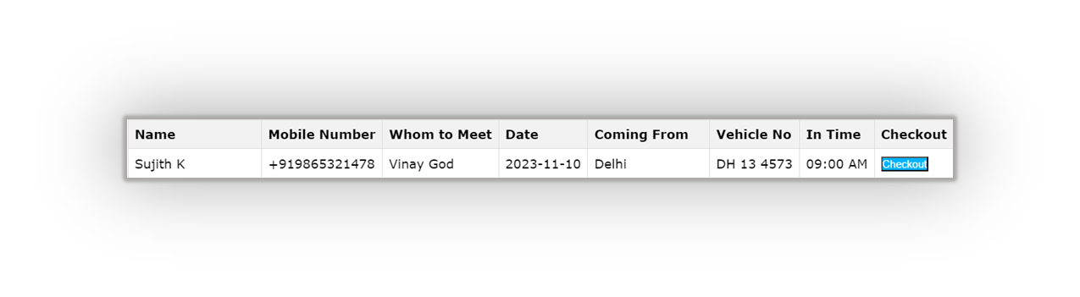
Simplified Exit Process
User-friendly checkout functionality.
Swift logging of visitor departures.
After Check Out the User Information will be Transferred from Current Visitors to Previous Visitors.

Slide 13

User Authentication using Cookies and JWT
Upon user login, a JWT token is created and securely stored in a cookie.
Subsequent requests automatically carry this token, enabling smooth server authentication without re-entering credentials.
Avoids direct storage of sensitive data in cookies, bolstering overall security.
Upon logout, associated session cookies are automatically cleared, ensuring a secure logout process.

Slide 14

Password Hashing & Environment Variables
Implemented robust security using bcrypt for password hashing.
Offers unwavering protection against unauthorized access and secures sensitive user information in our web application.
Prioritized security by using environment variables for sensitive data.
Enhanced overall site security and facilitated efficient management of secrets without modifying the core codebase.

Slide 15

Thank you!!!

